Slide 1
Tidy Tuesday Should you be afraid of tornados
Ziping, Ole, Kristian

Slide 2
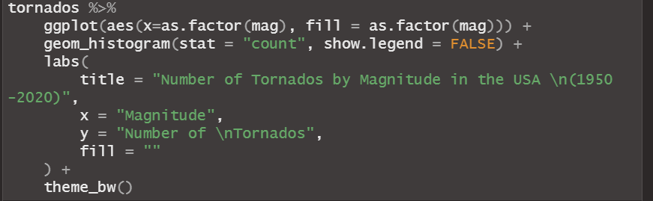
Occurrences of Tornados by magnitude in the USA since 1950 - 2022:

Slide 3
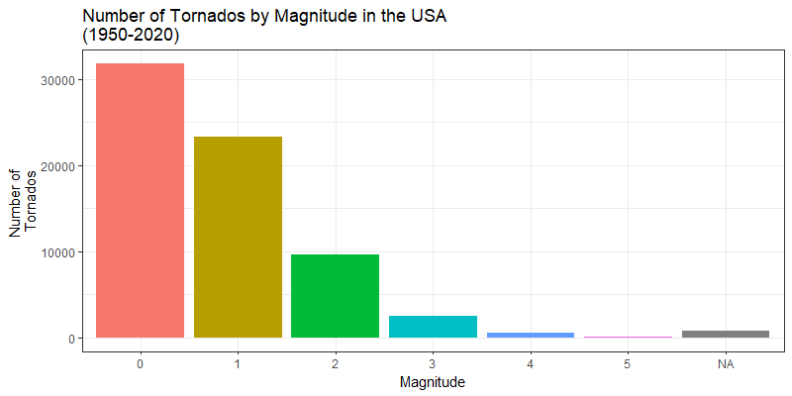
Occurrences of Tornados by magnitude in the USA since 1950 - 2022:

Slide 4
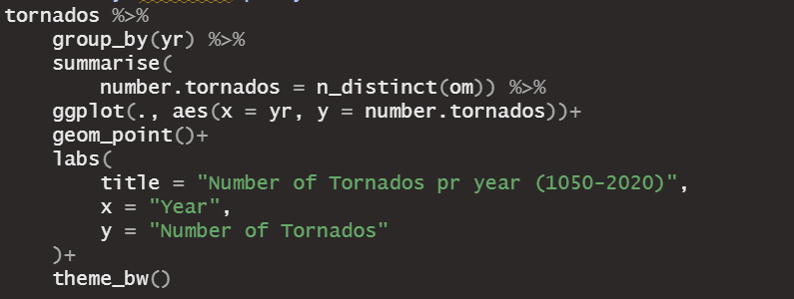
Tornados by year

Slide 5
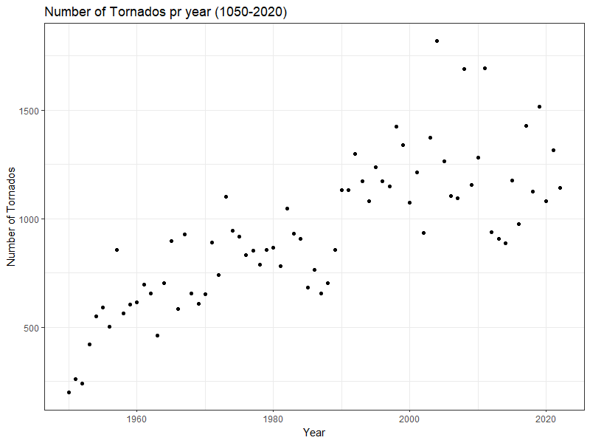
Tornados by year

Slide 6
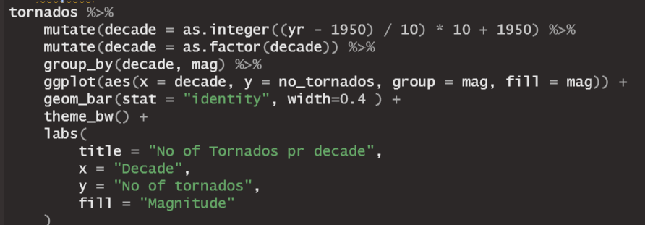
Number of tornados by year and magnitude

Slide 7
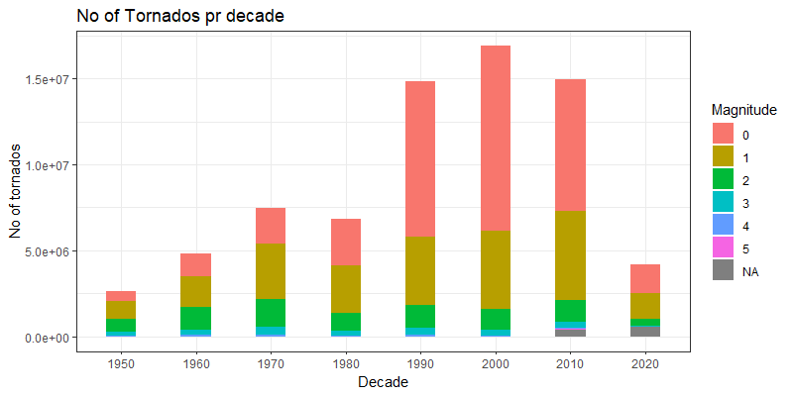
Number of tornados by year and magnitude

Slide 8
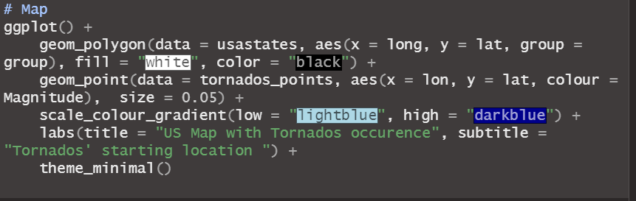
Where do Tornados occur?

Slide 9
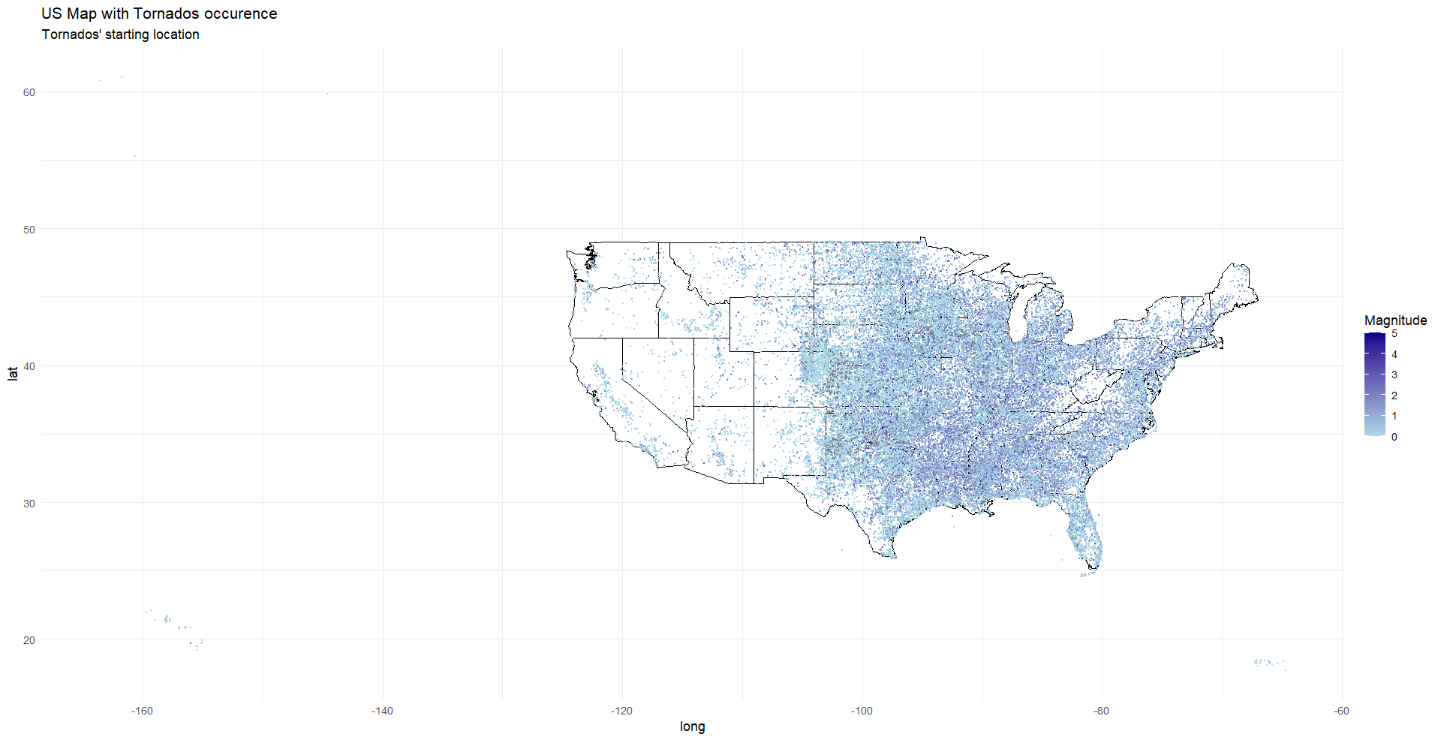
Where do Tornados occur?

Slide 10
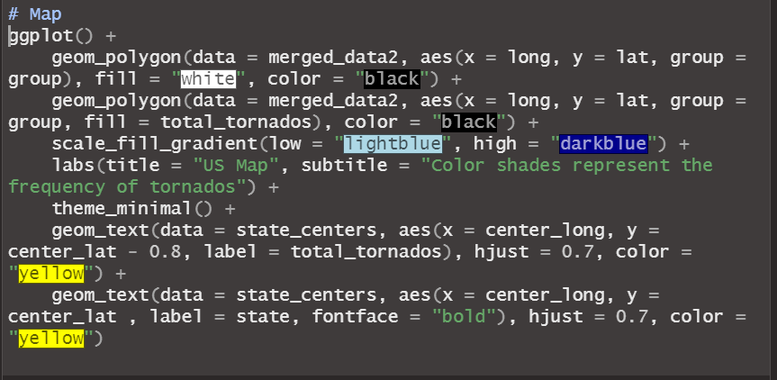
Frequencies of Tornadoes pr State in the USA:

Slide 11
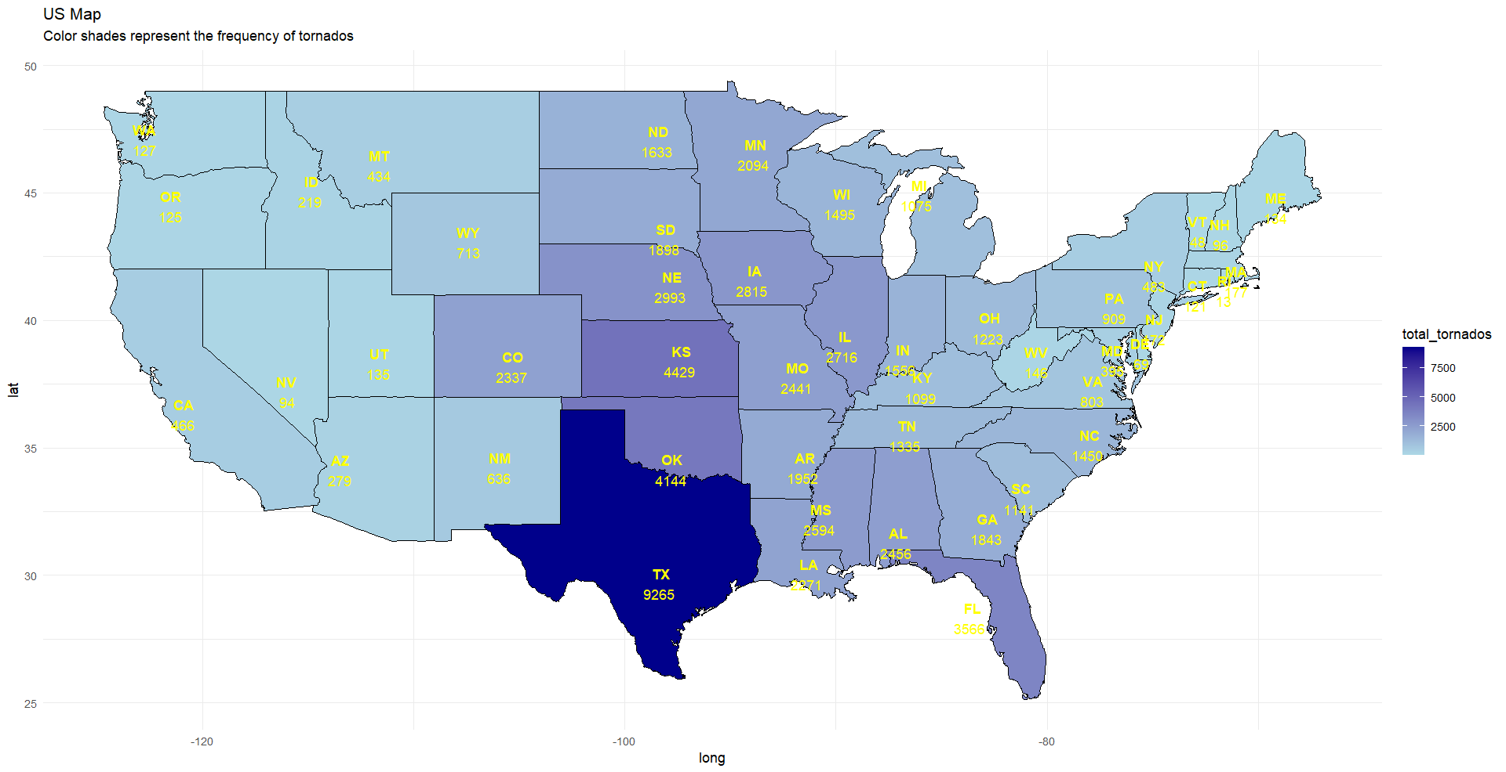
Frequencies of Tornadoes pr State in the USA:

Slide 12
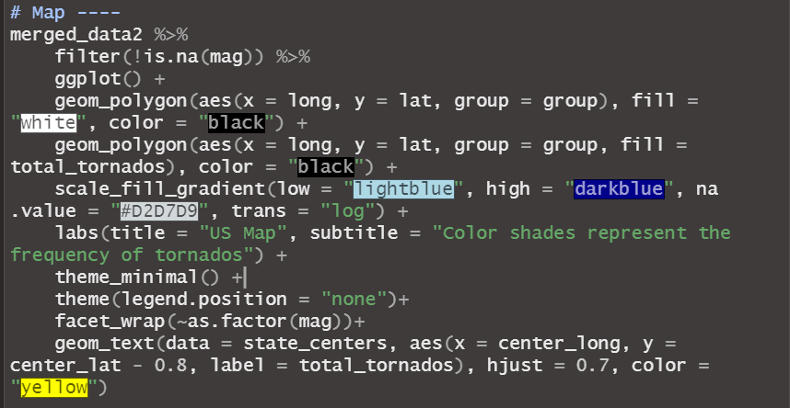
Where do the most severe Tornados occur:

Slide 13
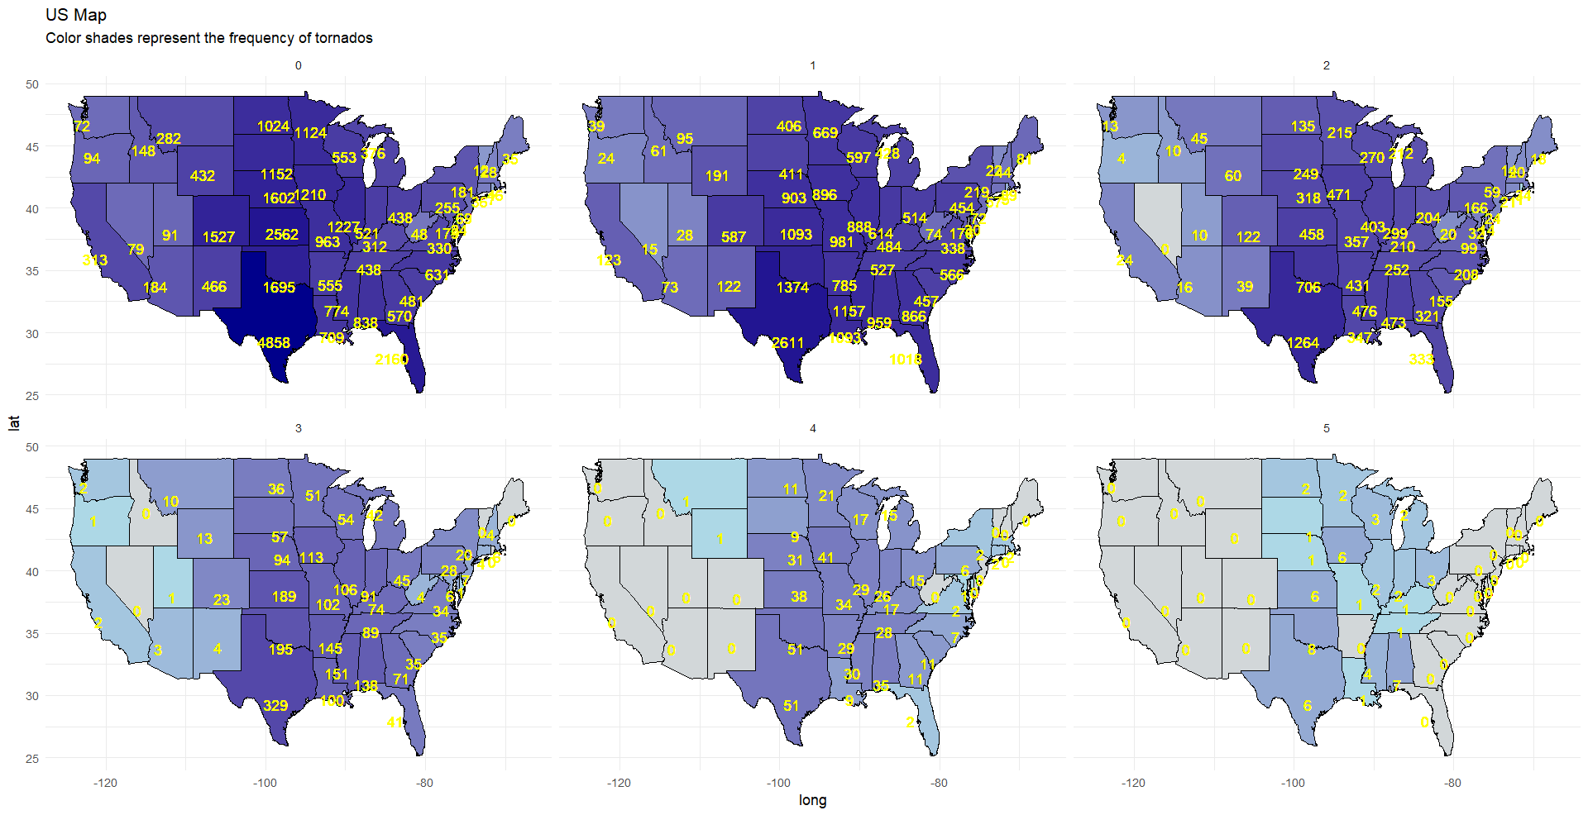
Where do the most severe Tornados occur:

Slide 14
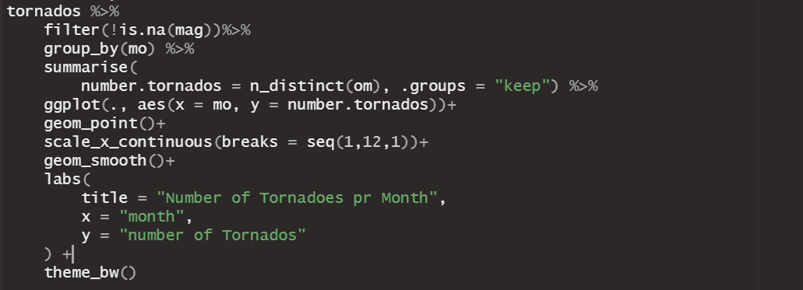
Tornados by season

Slide 15
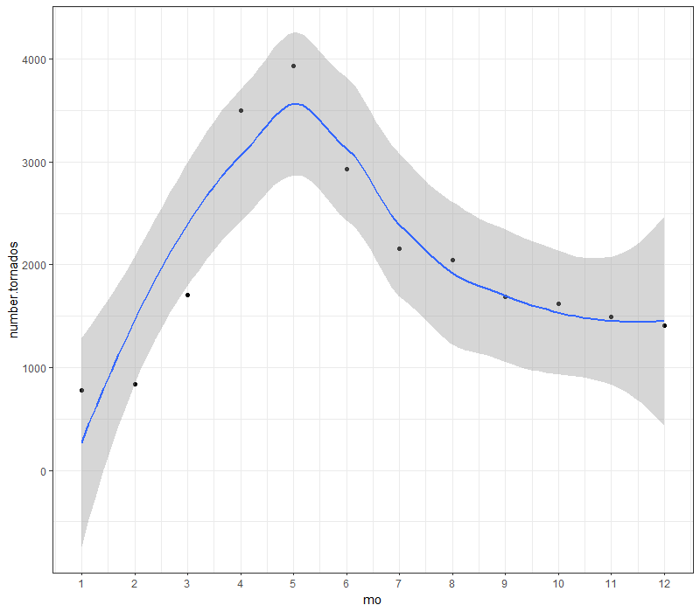
Tornados by season

Slide 16
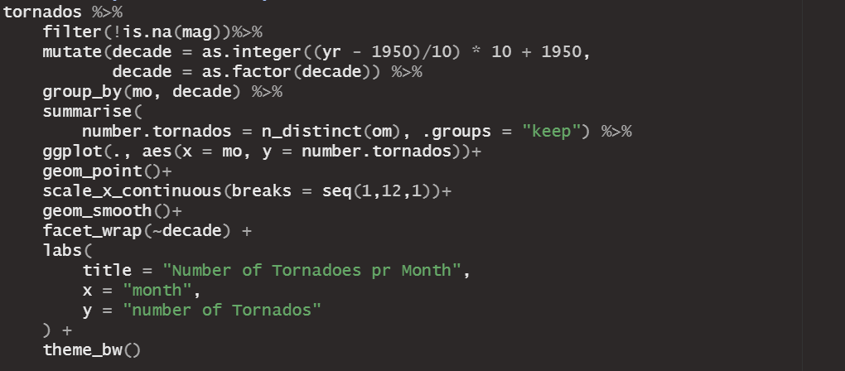
Tornados by season by decade

Slide 17
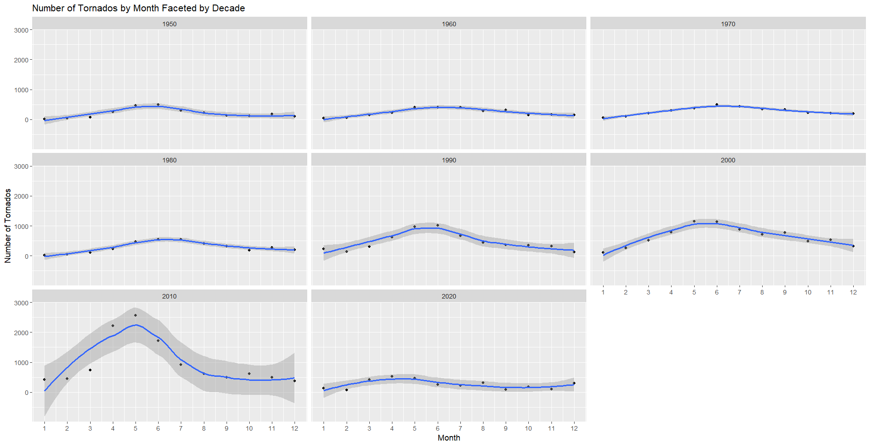
Tornados by season by decade

Slide 18
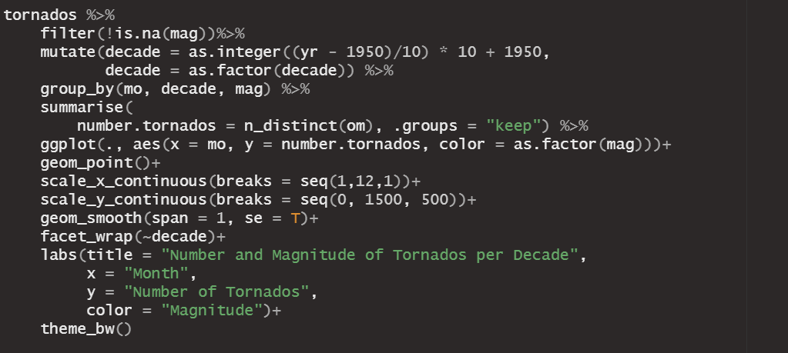
Tornados by season, magnitude and decade

Slide 19
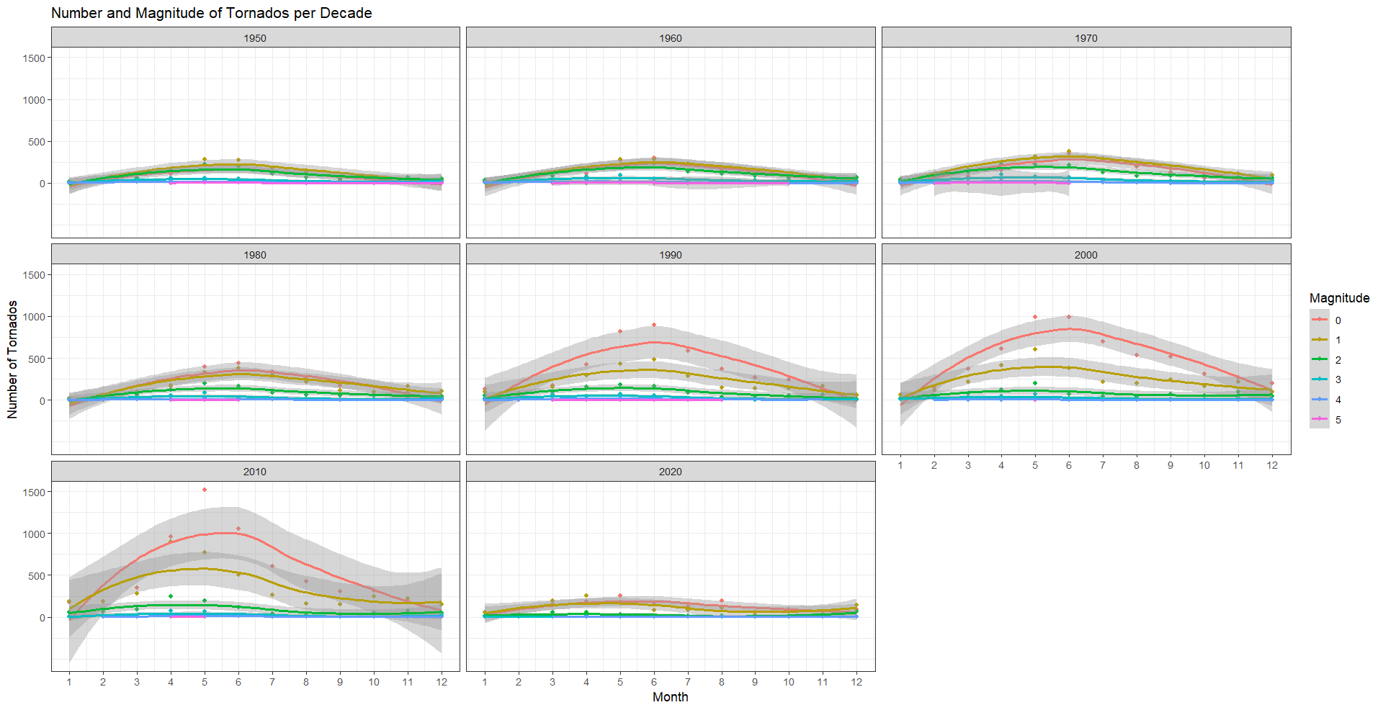
Tornados by season, magnitude and decade

